Slide 1
CSS Position
CSS Positioning Demo

Slide 2
Positioning
Using CSS, you can place elements exactly on a page using a technique called “positioning.” Positioning is determined by an X axis and Y axis. To specify a specific point on the screen, you can use the X and Y coordinate for that point.
There are several ways to specify position in CSS: absolute, relative, fixed, inherit, and static,sticky.
The three most often used are absolute, relative, and fixed.
Static positioning is the default
The top, bottom, left, and right properties are used with position to set the placement of an element.

Slide 3
position: static;
HTML elements are positioned static by default.
Static positioned elements are not affected by the top, bottom, left, and right properties.
An element with position: static; is not positioned in any special way; it is always positioned according to the normal flow of the page:

Slide 4
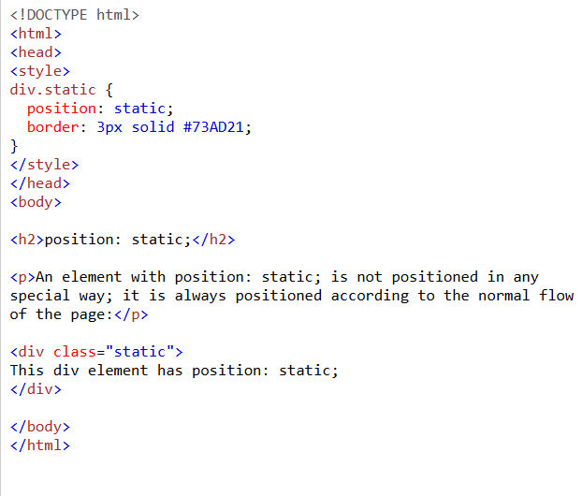
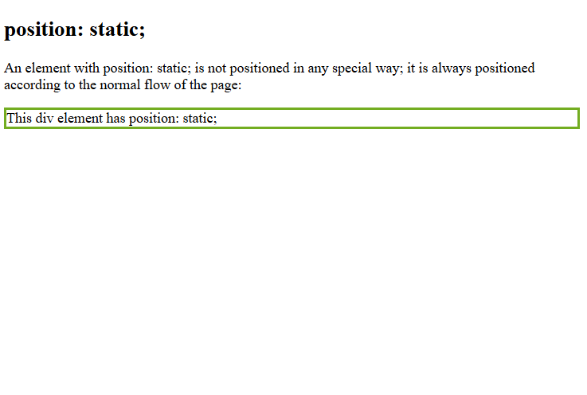

Slide 5
position: relative;
An element with position: relative; is positioned relative to its normal position(static/default).
Setting the top, right, bottom, and left properties of a relatively positioned element will cause it to be adjusted away from its normal position. Other content will not be adjusted to fit into any gap left by the element.

Slide 6
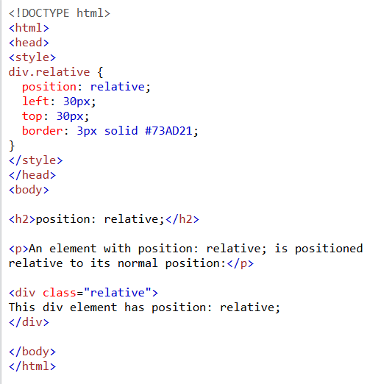
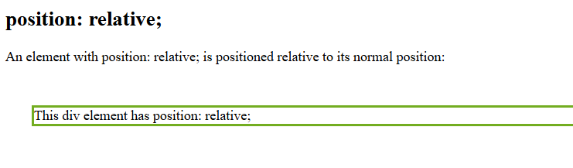

Slide 7
position: fixed;
An element with position: fixed; is positioned relative to the viewport, which means it always stays in the same place even if the page is scrolled. The top, right, bottom, and left properties are used to position the element.

Slide 8
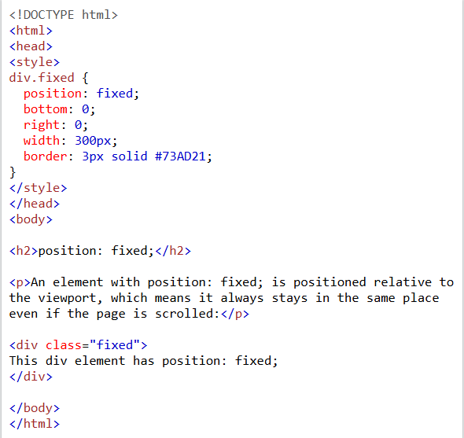
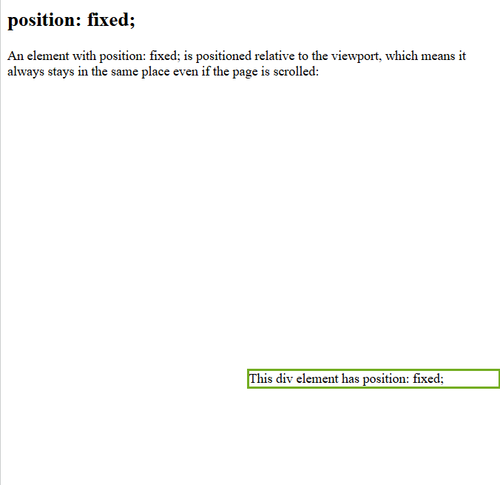

Slide 9
position: absolute;
An element with position: absolute; is positioned relative to the nearest positioned ancestor (instead of positioned relative to the viewport, like fixed).
However; if an absolute positioned element has no positioned ancestors, it uses the document body, and moves along with page scrolling
it also allows objects to be placed one on top of another.

Slide 10
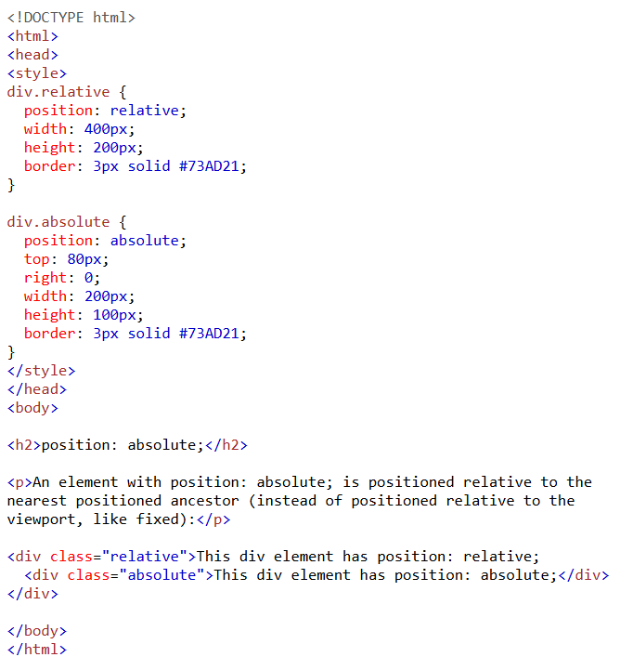
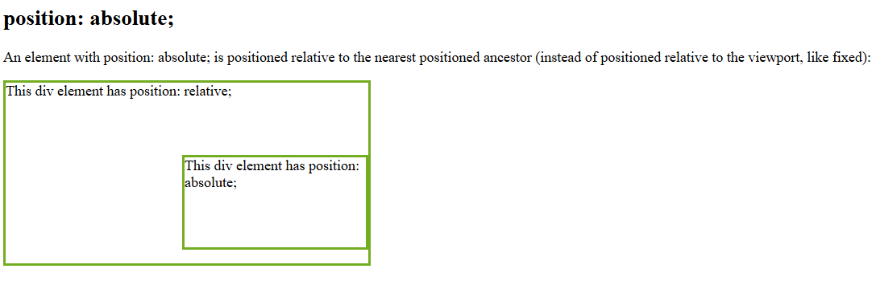

Slide 11
Layers and the “Bounding Box”
When the browser draws an object on a page, it places it into an invisible rectangular space called a “bounding box.” You can set the box’s exact location on the page or offset it from other objects on the page. As mentioned in the previous slides, you can also specify the size of the box.
With CSS, these boxes can be stacked one on top of another as layers. Horizontal and vertical positioning happen along the X and Y axes, and the layered positioning happens along the Z axis.
The Z axis is set using the CSS style z-index, which allows you to specify which layer appears on top of the others. By setting the z-index higher or lower, an object can move up and down a stack. The higher the z-index, the more “on top” it is.

Slide 12
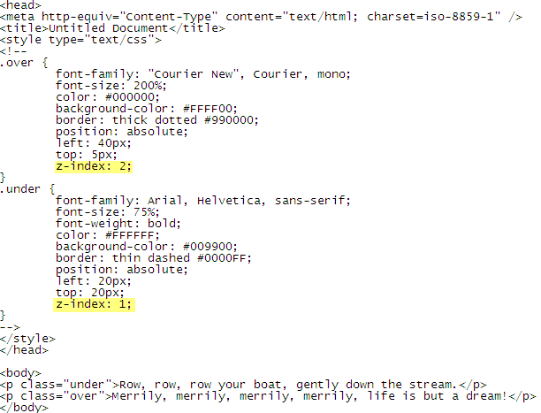
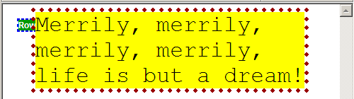
Layering Example 1

Slide 13
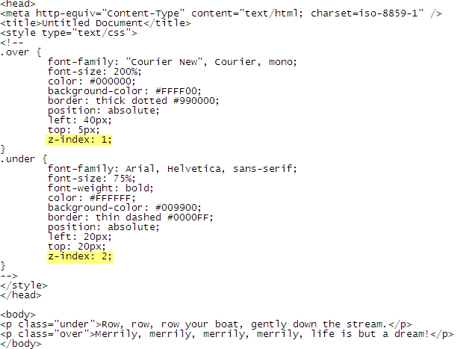
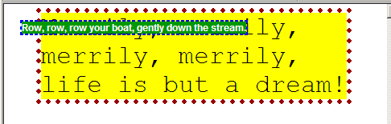
Layering Example 2

Slide 14
Reference
https://csszengarden.com/
https://www.w3schools.com/cssref/tryit.php?filename=trycss_display
https://www.w3schools.com/cssref/playdemo.php?filename=playcss_display&preval=inline
https://www.w3schools.com/cssref/tryit.php?filename=trycss_display

